Slide 1
Macmillan
Cancer Support

Slide 2
Today we are going to be doing a power point on Macmillan Cancer Support to help raise money! If you would like to help us, you can buy our cakes.
This will be all about Macmillan and how to help them!
We really hope that you enjoy this power point, just as much as you will enjoy your delicious cakes! ☺

Slide 3
Macmillan Cancer Support provide services for those people with cancer and their families.
This could be physical, financial or emotional.
Throughout the year money is raised to support Macmillan including people holding coffee mornings alongside other fundraising activities.

Slide 4
Macmillan Nurses
Macmillan Nurses are very special cancer nurses. They help people to understand their treatment and support them all the way through it! ☺
If you need support, visit Macmillan.org.uk.

Slide 5
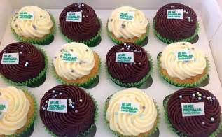
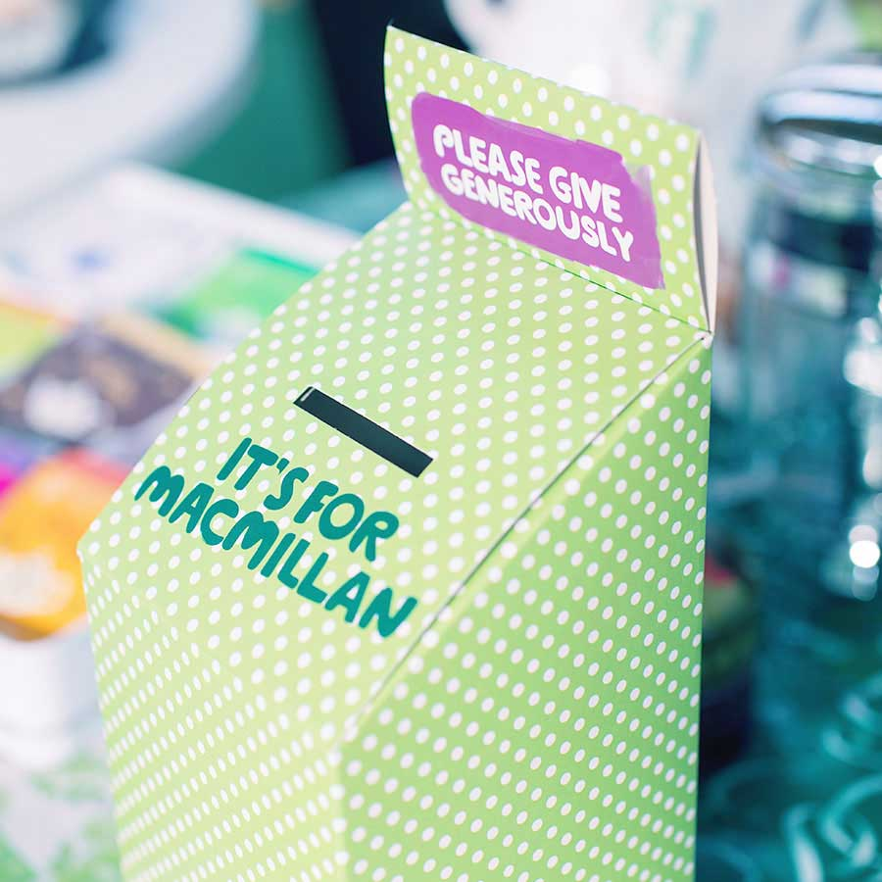
How to donate to Macmillan Cancer Support.
Buy our cakes!
You can place any donations in our collection boxes!

Slide 6
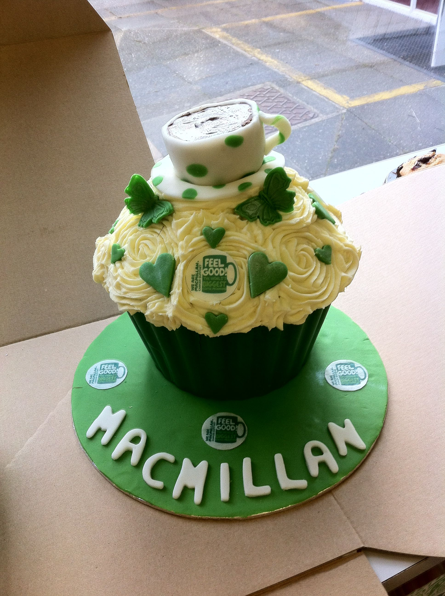
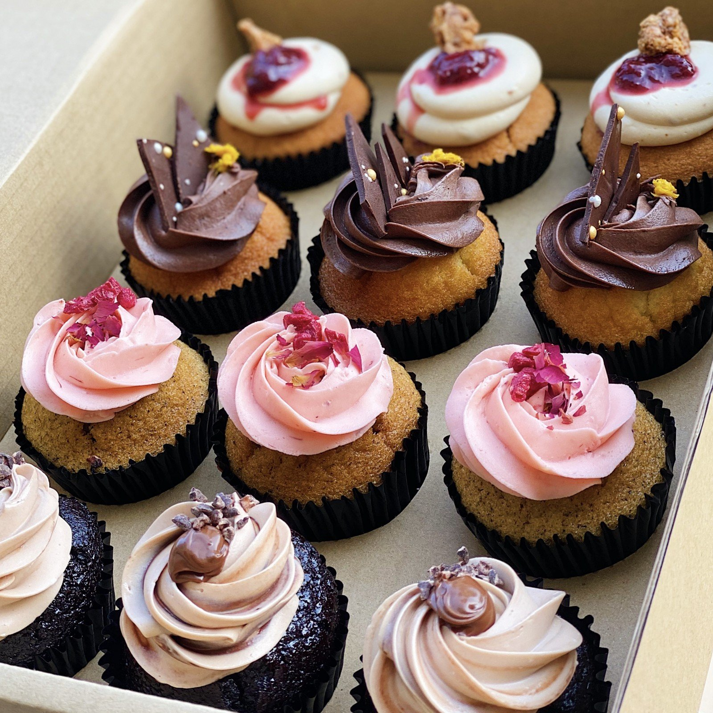
Cakes – donation of silver coins. ( 10p, 20p, 50p ect.)

Slide 7
Thank you all for watching this slideshow, we hoped that you enjoyed it! Our JLT (junior leadership Team) worked very hard on this. ☺

