Slide 1



Slide 2
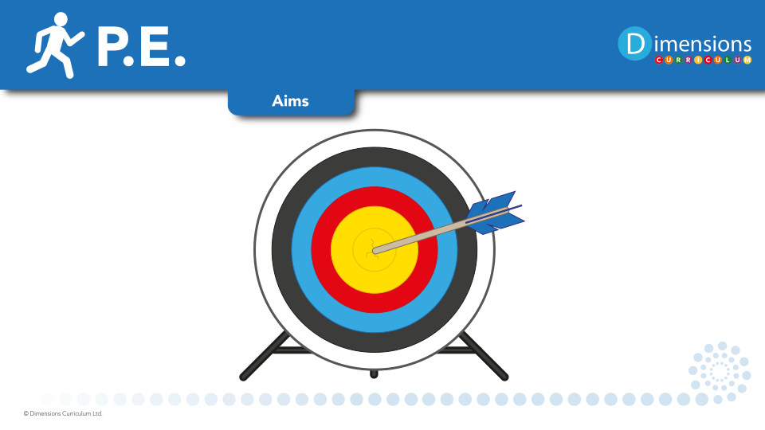
At Broadbottom we aim to:
Ensure that every child has a minimum of 2 hours physical education each week.
Develop competence in all our pupils to excel in a broad range of physical activities.
Engage pupils in competitive sports and activities
Promote the importance of leading healthy and active lives
Embed an understanding of the purpose of good nutrition values

Slide 3


Slide 4

PE helps pupils to aspire to achieve personal and shared goals.

Slide 5
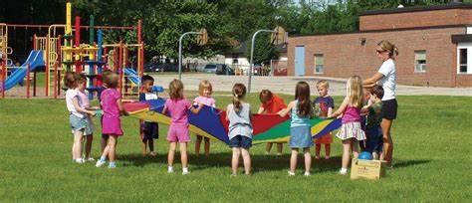
Physical Education encourages pupils to work as a team and develop a sense of fair play and team spirit.

Slide 6

PE helps pupils to remain active, agile and healthy. It boost their energy levels and improves self esteem, confidence and mental health.

Slide 7
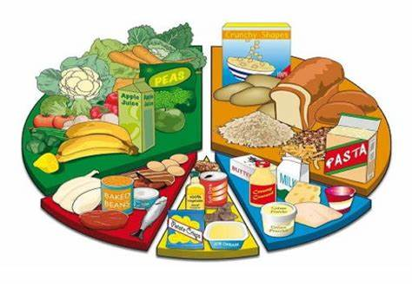
PE teaches pupils how to make healthy food choices and the values of good nutrition.

Slide 8
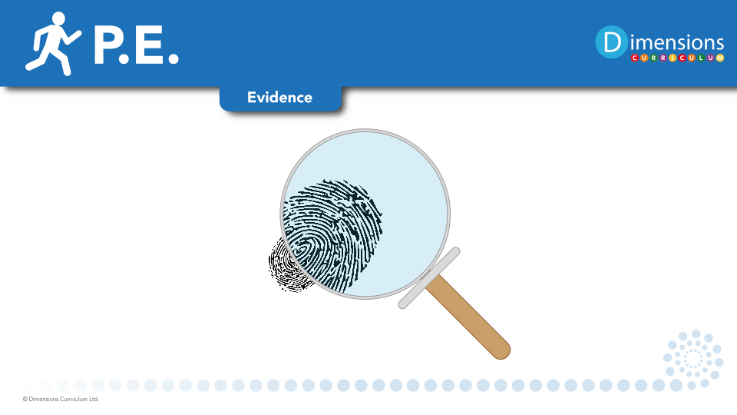

Slide 9

Learning walks
Kahoot quizzes
Pupil voice
Moderation

