Slide 1


RSE

Slide 2
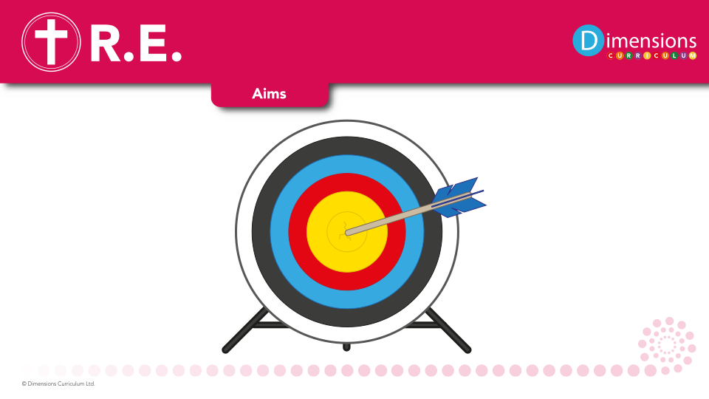
RSE
At Broadbottom we aim to:
Help pupils develop feelings of self respect, confidence and empathy.
Create a positive culture around issues of sexuality and relationships.
Prepare pupils for puberty and give them an understanding of sexual development and the importance of health and hygiene.
Teach pupils the correct vocabulary to describe themselves and their bodies.

Slide 3

RSE helps pupils understand the fundamental building blocks and characteristics of positive relationships.

Slide 4
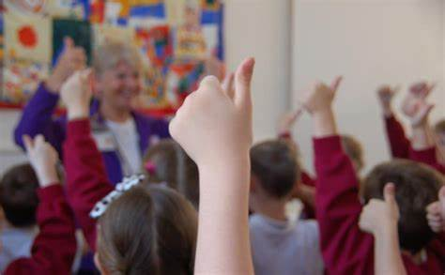
RSE provides pupils with the skills and knowledge they need to have safe, fulfilling relationships, take responsibility for their sexual health, and feel secure and happy in their sexuality

Slide 5

RSE educates pupils about the rules and principles for keeping safe online, how to spot risks and harmful content and how to report it and help and support

Slide 6
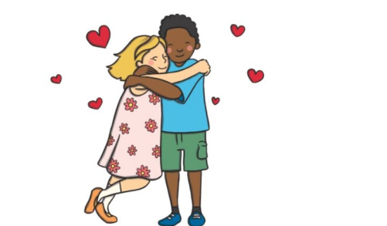
RSE helps to prepare children for changes like puberty and the transition into adult life. In schools, it can serve to provide a secure environment where pupils can feel comfortable asking questions they might not want to ask elsewhere.

Slide 7

RSE
Books
Learning walks
Kahoot quizzes
Time machine
Pupil voice
Moderation

