Slide 1




Slide 2
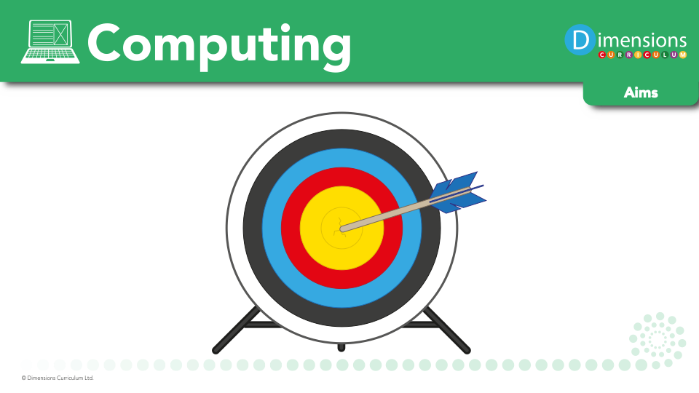
At Broadbottom we aim to:
Deliver a vibrant and interesting curriculum.
Support pupils in the acquisition of knowledge, key concepts, terms, and vocabulary.
Ensure pupils have the skills and confidence to become problem solvers and digital innovators of the future.
Use project-based learning activities to provide pupils with the opportunity to apply and consolidate their knowledge and understanding.
Be independent users of digital technology, doing so safely, respectfully and responsibly.

Slide 3

Computing encourages pupils to use logical reasoning to predict the behaviour of simple programs.

Slide 4
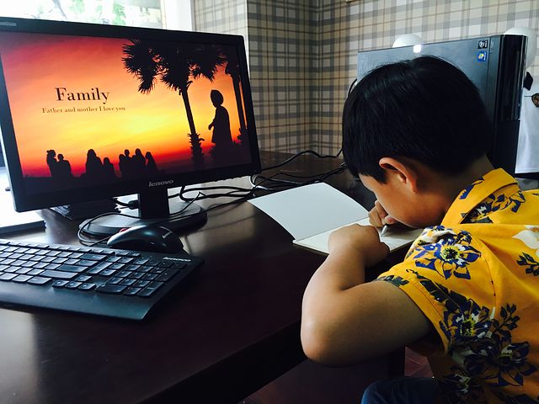
Computing develops pupils’ skills in using technology to create, organise, store, manipulate and retrieve digital content

Slide 5

Computing teaches pupils how to flourish in a connected world, developing their sensitivity to others online, treating them with respect, and showing respect for their privacy as well as teaching pupils how to keep safe online and where to go for help and support.

Slide 6

Critical thinking and analytical skills are developed through computing.

Slide 7

Computing nurtures pupils’ collaboration skills, as they work together and support one another in their learning.

Slide 8
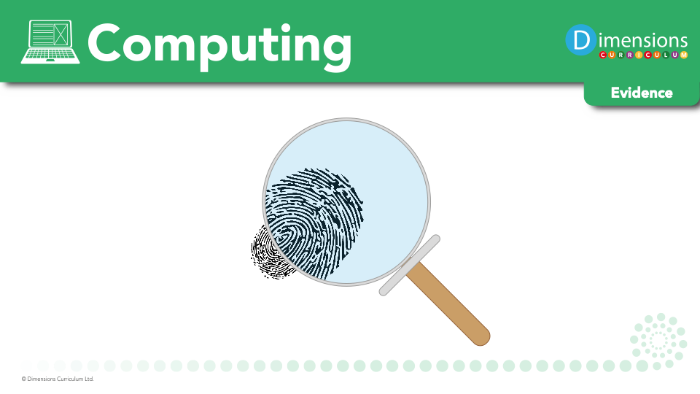

Slide 9

Books
Learning walks
Kahoot quizzes
Time machine
Pupil voice
Moderation

