Slide 1
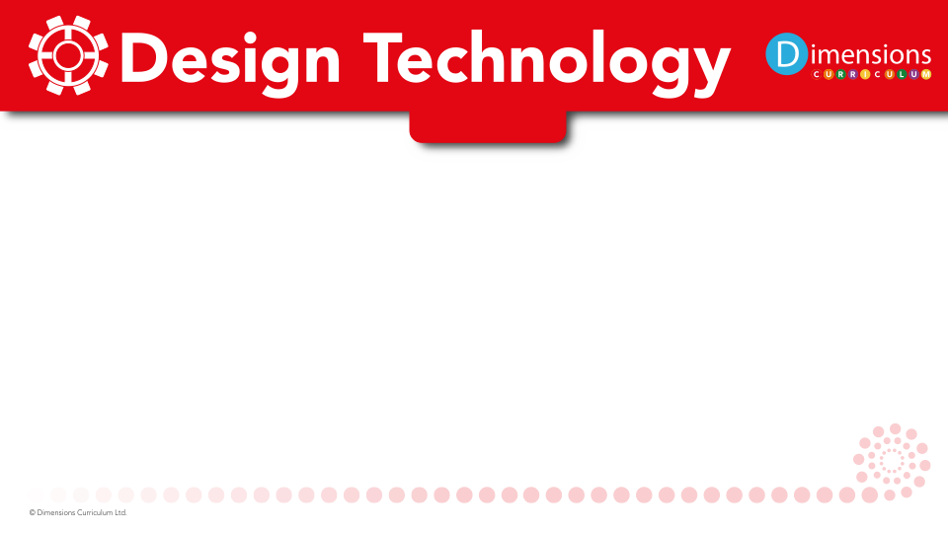



Slide 2
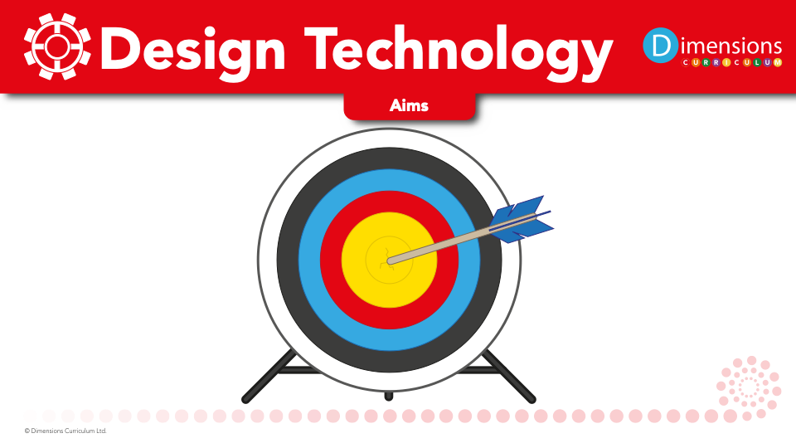
At Broadbottom, we aim to:
encourage pupils to be reflective and determined learners
develop skills through the design, make and evaluate process
enable pupils to make connections with the subject in real life

Slide 3

Design Technology gives pupils the opportunity to develop skills, knowledge and understanding of designing and making functional products.

Slide 4
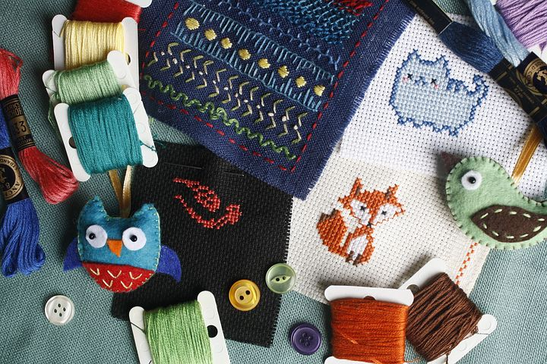
Design Technology develops pupils’ practical skills and techniques as they apply these to designing and making prototypes and products.

Slide 5

Design Technology helps children to problem-solve, making on-going changes and improvements during the design and make process.

Slide 6

Design Technology allows pupils to build and apply a repertoire of knowledge, understanding and skills to design and make high-quality prototypes and products for a wide range of users.

Slide 7
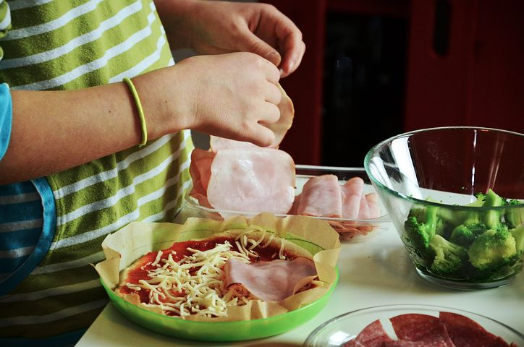
Design Technology teaches pupils to understand and apply the principles of nutrition and learn how to cook.

