Slide 1




Slide 2
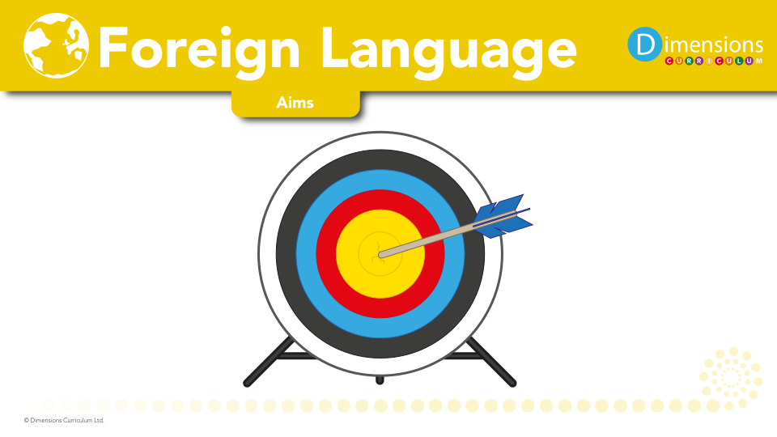
At Broadbottom we aim to
Deliver MFL as we believe it provides a valuable educational, social and cultural experience for our pupils.
Develop communication skills, including key skills in speaking, listening, reading and writing.
Provide lessons that support children’s knowledge of how language works is developed and extended.

Slide 3

Understand and respond to the spoken and written language of German.

Slide 4

Language will give pupils a new and broader perspective on the world, encouraging them to understand their own cultures and those of others

Slide 5

Pupils develop an appreciation of a variety of stories, songs, poems and rhymes in German

Slide 6

.
Modern Foreign Languages develops oracy, literacy and intercultural understanding.

Slide 7

The linguistic skills gained will lay the foundations for further language learning as our pupils move into Key Stage 3.

Slide 8


Slide 9
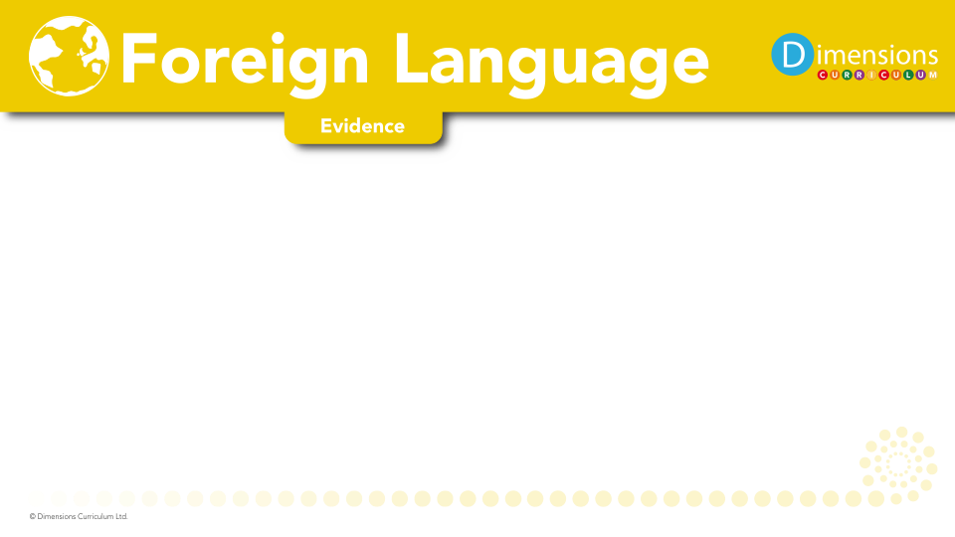
Books
Learning walks
Kahoot quizzes
Time machine
Pupil voice
Moderation

