Slide 1




Slide 2
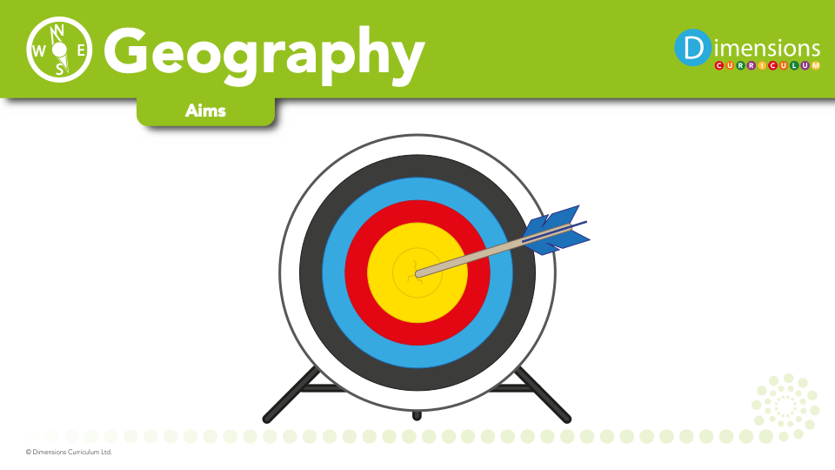
At Broadbottom, we aim to:
inspire pupils’ curiosity and fascination about the world, and its people, that will remain with them for the rest of their lives
equip pupils with knowledge about diverse places, people, resources and natural and human environments
deepen understanding of the Earth’s key physical and human processes
help pupils make links between physical and human processes
Help pupils understand the formation of, and use of, landscapes and environments

Slide 3
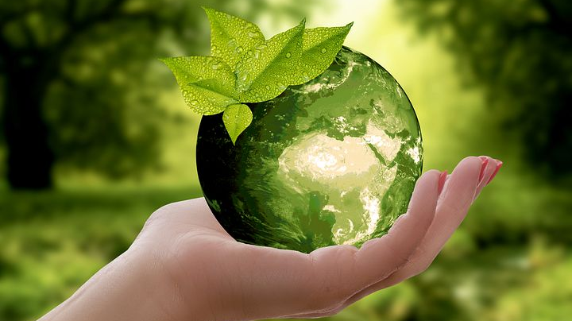
Geography develops pupils’ understanding and appreciation of places and their importance to us, of our impact on them and how we can manage and develop them sustainably.

Slide 4
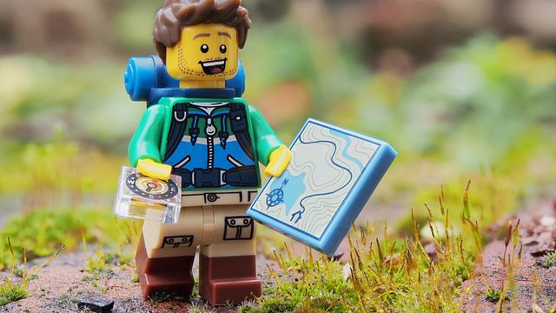
The geography that children learn is brought `alive’ for them through investigating and asking questions about the world.

Slide 5
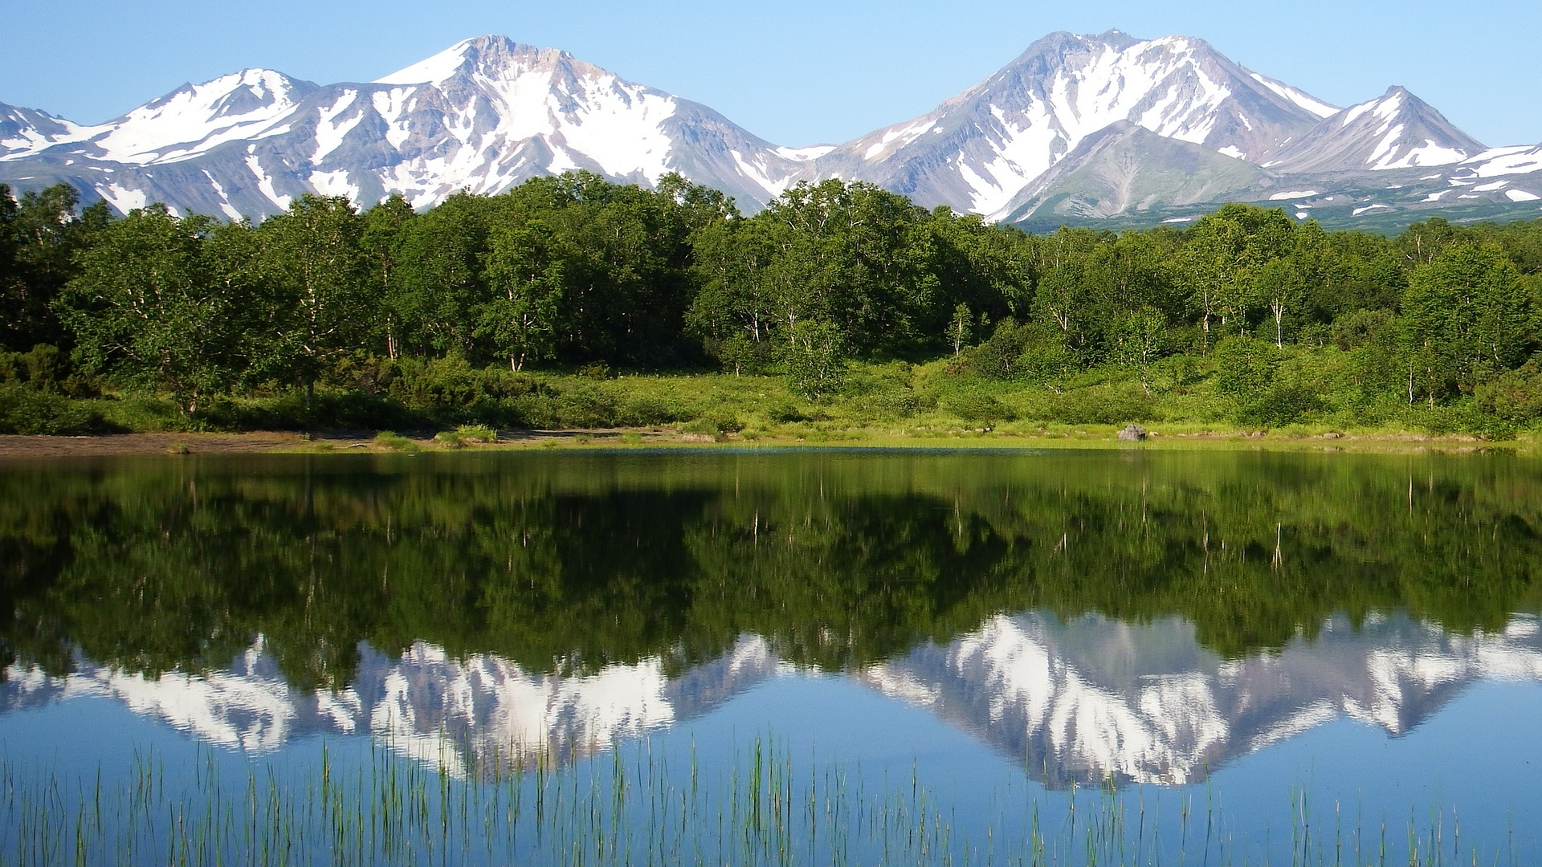
Geography teaches pupils to understand `space’ and ‘scale’, including the layout of places within their own locality, their own country and the wider world and how this can be represented on maps.

Slide 6
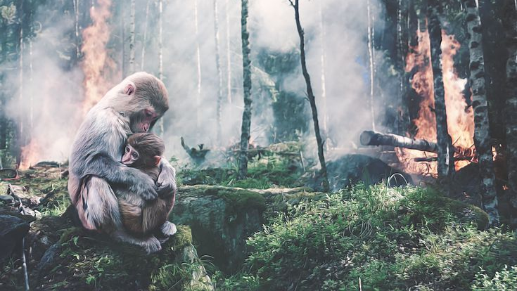
Geography helps pupils recognise and value interdependence through themes such as climate change, food, water and energy.

Slide 7
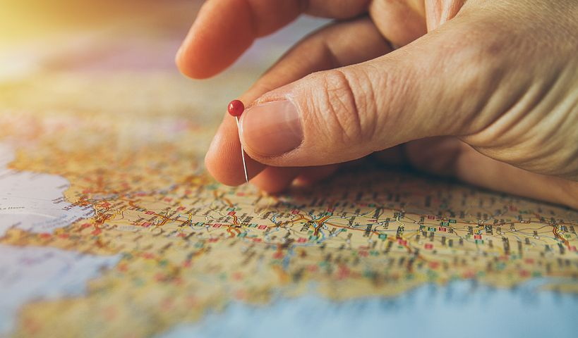
Geography teaches pupils to appreciate the diversity evident in the world, through learning about similarities, differences and how we live interdependently.

Slide 8

Books
Learning walks
Kahoot quizzes
Time machine
Pupil voice
Moderation

