Slide 2
At Broadbottom we aim to:
Develop curiosity, so that pupils want to engage actively with historical issues, ask relevant questions and think critically when searching for answers.
Introduce pupils to diversity within societies and the relationships between different groups over time.
Through chronology, enable pupils to make connections between different periods from the past and the present.
Engage pupils' creative and critical thinking about change, both locally and globally, and the implications for the future.
Develop a passion and love for history.

Slide 3
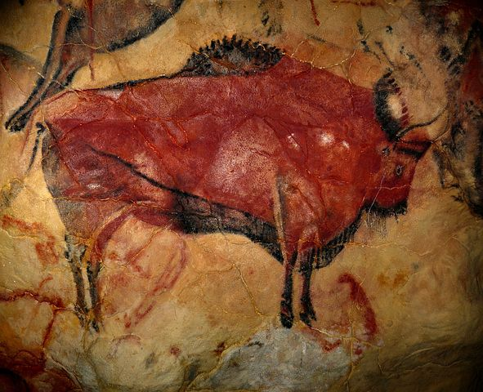
History enables pupils to explore cause and consequence, identifying catalysts for change, the effects on societies and reasons for developments.

Slide 4
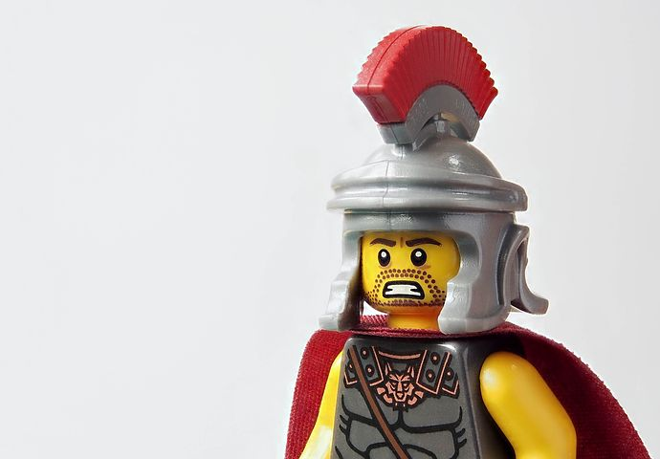
History inspires pupils’ curiosity, leading them to ask relevant questions and think critically when searching for answers.

Slide 5
Pupils historical knowledge and skills are developed through analysing and judging different sources of evidence and understanding its importance when piecing together the past.

Slide 6
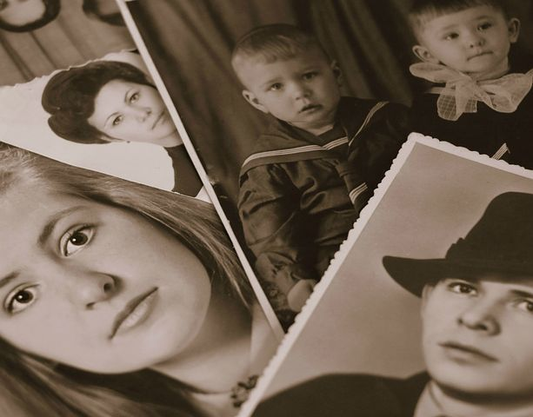
Chronology helps pupils see the ‘big picture’ of the historical narrative, enabling pupils to make connections made between different periods from the past and the present.

Slide 7
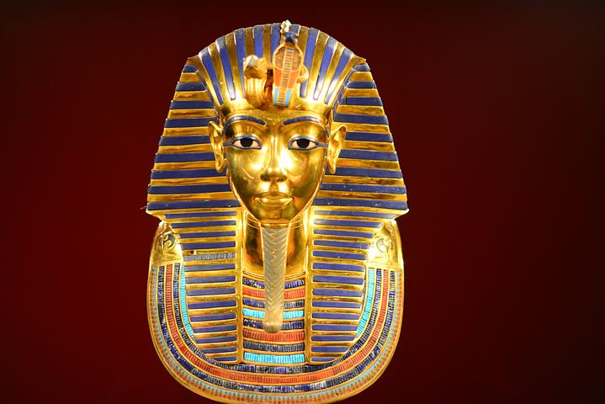
History helps pupils gain a coherent knowledge and understanding of their country’s past and that of the wider world.

Slide 8
Books
Learning walks
Kahoot quizzes
Time machine
Pupil voice
Moderation

