Slide 1



READING

Slide 2

READING
At Broadbottom we aim to:
Put reading at the very heart of teaching.
Promote a love of reading, where pupils are passionate about books and authors.
Provide pupils with a secure grasp of phonics, to build confidence and fluency in early reading and writing.
Ensure all pupils have access to high quality texts, throughout all subjects.
Develop skills in Grammar, Punctuation and Spelling to enable pupils to create their own texts.
Provide drama and role-play opportunities which allow the pupils to explore their own feelings
Develop speaking and listening skills and learn about the world around them.

Slide 3

Reading is essential. Once you can read, the world opens up to you.
Enter Text

Slide 4
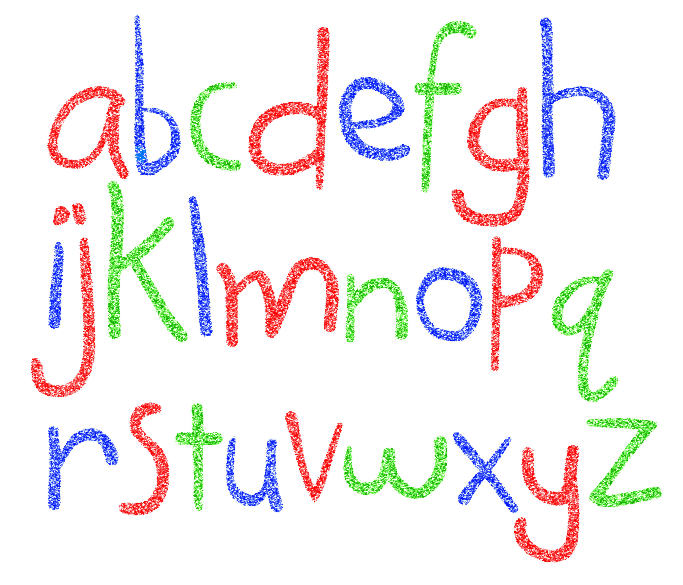
Phonics are the building blocks of reading and writing. Through regular, structured sessions, pupils become independent readers and writers quickly.
This Photo by Unknown Author is licensed under CC BY

Slide 5

Building knowledge in the grammatical structure of language enables pupils to create their own texts.

Slide 6

Using high quality texts throughout the curriculum, provides pupils with models of good writing.
Enter Text
This Photo by Unknown Author is licensed under CC BY-NC

Slide 7


Slide 8

READING

Slide 9

READING
Books
Learning walks
quizzes
Pupil voice
Moderation

